Slide 1
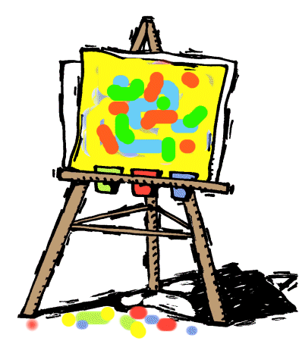
ART:
PROCESS
vs.
PRODUCT

Slide 2
Goals:
To encourage children’s creativity through developmentally appropriate art experiences
To develop motor skills
To reinforce concepts taught

Slide 3
Process-Focused art experiences
No step-by-step instruction
No sample for children to follow
No right or wrong way to explore and create
Based on the experience and exploration of techniques, tools, and materials
Unique and original
Experience is relaxing or calming
Art is children’s own
Art is child’s choice
Ideas are not readily available online

Slide 4
What children might say
“Look what I made!”
“I am going to make another one!”
“Can I have more time?”

Slide 5
Product-focused experience
Children have instructions to follow
Teacher created sample to follow
There is a right and a wrong way to proceed
There is a finished product in mind
The children’s finished art all looks the same
The children experience frustration
The teacher might “fix” mistakes
The whole class took part in art project at the same time
Patterns and examples are available online

Slide 6
Process-focused activities
Easel painting
Watercolor painting
Exploring and creating with clay
Finger painting
Painting with unusual tools like toothbrushes, paint rollers, combs, blocks
Printing and stamping
Creating spin art
Stringing beads
Weaving cloth, yarn, paper

Slide 7
More Process-focused activities
Drawing with pencils, art pens, various sizes of markers, or crayons
Using homemade dough
Making collages with tissue paper, various sizes of paper, glue, paste, glue sticks, scissors, old magazines,and recycled materials

Slide 8
What children might say
“Can I be done now?”
“Is this right?”
“I can do it.”
“Mine does not look like yours.”

Slide 9
Process Scale

Slide 10
Product-Focused Art

Slide 11
Process-focused art

Slide 12
Process vs. Product

Slide 13
Process-Focused art

Slide 14
Process-focused art

Slide 15
Process-focused art

Slide 16
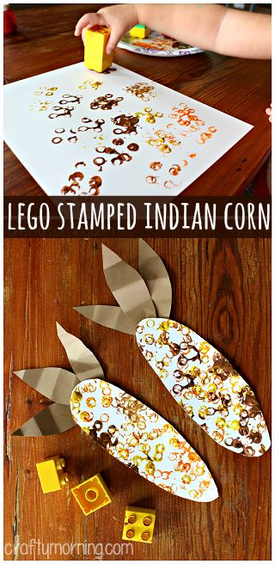
More samples:

Slide 17
More samples:

Slide 18
More Samples:

Slide 19
More samples:

Slide 20
More samples:

Slide 21
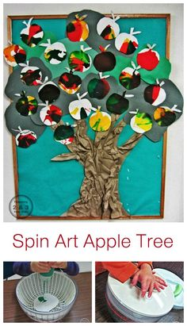
More samples:

Slide 22
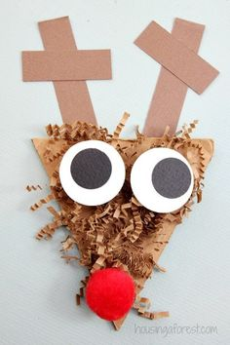
More samples:

Slide 23
Tips for leading Process-focused art
Approach art like open ended play by offering a variety of materials
Let children use more paint, more colors and more artwork
Play music in the background
Display children’s books with artful illustrations, such as those by Eric Carle, Lois Ehlert, and Javaka Steptoe
Remember that it is the children’s art, not yours

Slide 24
What Children do and Learn through process-focused art
Social and emotional- Children relax, focus, feel successful, and can express their feelings
Language and literacy-Children may discuss their art and print or dictate to teacher
Cognitive-Children compare, predict, plan, and problem solve
Physical-Children use small motor skills to paint, write, glue, use clay, and make collages

Slide 25
Resources:
Bongiorno, L.(2011). How process art experiences support preschoolers. Teaching Young Children. 7 (3).Retrieved November 21, 2016 from http://www.naeyc.org/tyc/article/process-art-experiences
Clement, D. (2012, February 1).Children’s art: process versus product http://prekandksharing.blogspot.com/2012/02/childrens-art-process-versus-product.html

